Slide 1
Jeopardy!

Slide 2
Time to the minute | Quarter and Half | Units of Time | Elapsed Time | Working Backwards
100 | 100 | 100 | 100 | 100
200 | 200 | 200 | 200 | 200
300 | 300 | 300 | 300 | 300
400 | 400 | 400 | 400 | 400
500 | 500 | 500 | 500 | 500

Slide 3
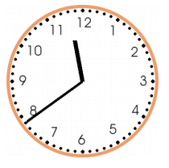
1-100 points
What time is shown on the clock?
Answer

Slide 4
Answer-100
11:39
Back

Slide 5
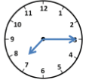
2-100 points
Using quarter to, quarter after, or half past, write the time shown on the clock below.
Answer

Slide 6
Answer-100
Quarter after 7
Back

Slide 7
3-100 points
How many minutes are in 4 hours?
Answer

Slide 8
Answer-100
240 minutes
1 hour=60 minutes
60 x4=240
Back

Slide 9
4-100 points
The child fell asleep at 12:20 pm and woke up at 12:55 pm. How long was the child asleep?
Answer

Slide 10
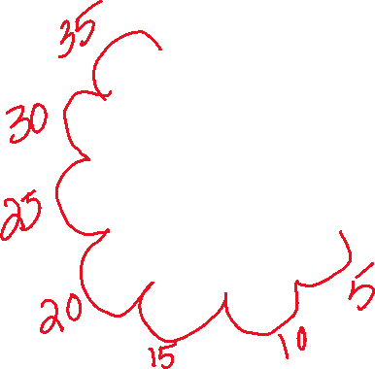
Answer-100
35 minutes
Back

Slide 11
5-100 points
Will arrived at his mother’s office at 3 pm. It took him 30 minutes to walk from his home to his mother’s office. What time did Will leave home?
Answer

Slide 12
Answer-100
2:30 pm
3:00-30 minutes=2:30
Back

Slide 13
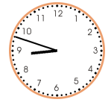
1-200 points
What time is shown below?
Answer

Slide 14
Answer-200
8:48
Back

Slide 15
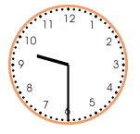
2-200 points
Using quarter to, quarter after, or half past, write the time shown on the clock below.
Answer

Slide 16
Answer-200
Half past 9
Back

Slide 17
3-200 points
How many days are in 6 weeks?
Answer

Slide 18
Answer-200
42 Days
1 week=7 days
7x6=42
Back

Slide 19
4-200 points
Lunch started at 12 pm and ended at 1:05 pm. How long did lunch last?
Answer

Slide 20
Answer-200
1 hour and 5 minutes
12:00-1:00= 1 hour
1:00-1:05= 5 minutes
Back

Slide 21
5-200 points
The test that Benjamin’s class took finished at 10:30 am. The first part of the test took 30 minutes. There was a 15-minute break. The second part of the test also took 30 minutes. At what time did the test start?
Answer

Slide 22
Answer-200
9:15 am
10:30-30min=10:00
10:00-15min=9:45
9:45-30 min=9:15
Back

Slide 23
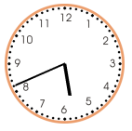
1-300 points
What time is shown on the clock below?
Answer

Slide 24
Answer-300
5:41
Back

Slide 25
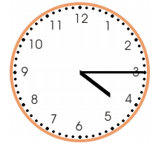
2-300 points
Using quarter to, quarter after, or half past, write what time is shown on the clock below.
Answer

Slide 26
Answer-300
Quarter after 4
Back

Slide 27
3-300 points
How many seconds are in 9 minutes?
Answer

Slide 28
Answer-300
540 seconds
1 minute=60 seconds
60x9=540
Back

Slide 29
4-300 points
Math class started at 1:30 pm and ended at 2:15 pm. How long did math class last?
Answer

Slide 30
Answer-300
45 minutes
1:30-2:00=30 minutes
2:00-2:15=15 minutes
30+15=45 minutes
Back

Slide 31
5-300 points
The temperature was 16°C when Becky returned home at 6 pm. The temperature was 4°C warmer at 3 pm than it was at 6 pm. It was 3°C warmer at 12 noon than it was at 3 pm. What was the temperature at 12 noon?
Answer

Slide 32
Answer-300
23°C
6 pm-16 °C
3 pm-4 °C warmer so 16+4=20 °C
12 noon-3 °C warmer so 20+3=23 °C
Back

Slide 33
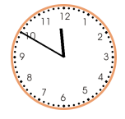
1-400 points
What time is shown on the clock below?
Answer

Slide 34
Answer-400
11:50
Back

Slide 35
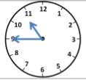
2-400 points
Using quarter to, quarter after, or half past, write the time shown on the clock below.
Answer

Slide 36
Answer-400
Quarter to 11
Back

Slide 37
3-400 points
How many hours are in 4 days?
Answer

Slide 38
Answer-400
96 hours
1 day=24 hours
24+24+24+24=96 hours
Back

Slide 39
4-400 points
The movie started at 6:45 pm and ended at 8:20 pm. How long did the movie last?
Answer

Slide 40
Answer-400
1 hour and 35 minutes
6:45-7:45= 1 hour
7:45-8:00=15 minutes
8:00-8:20 = 20 minutes
15+20=35 minutes
Back

Slide 41
5-400 points
Elliot finished studying at 4:45 pm. He spent 30 minutes reading a science chapter. He spent 45 minutes on his math homework. In between reading and math, Elliot took a 20-minute break. At what time did Elliot begin studying?
Answer

Slide 42
Answer-400
3:10 pm
4:45-45 minutes=4:00
4:00-30 min=3:30
3:30-20 min=3:10
Back

Slide 43
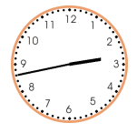
1-500 points
What time is shown on the clock below?
Answer

Slide 44
Answer-500
2:43
Back

Slide 45
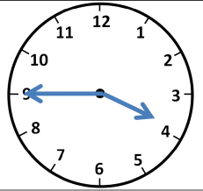
2-500 points
Using quarter to, quarter after, or half past, write the time shown on the clock below.
Answer

Slide 46
Answer-500
Quarter to 4
Back

Slide 47
3-500 points
How many days are in 2 weeks and 5 days?
Answer

Slide 48
Answer-500
19 days
1 week=7 days
7x2=14 days
14+5=19 days
Back

Slide 49
4-500 points
The game started at 5:30 pm and ended at 10:05 pm. How long did the game last?
Answer

Slide 50
Answer-500
4 hours and 35 minutes
5:30-6:30=1 hour 6:30-7:30=2 hours 7:30-8:30-3 hours 8:30-9:30=4 hours | 9:30-10:00=30 minutes 10:00-10:05=5 minutes 30+5=35 minutes
Back

Slide 51
5-500 points
At 12 noon, Leslie recorded the temperature as 56°F. The temperature had increased by 8°F from 10 am. The temperature at 8 am was 2°F warmer than it was at 10 am. What was the temperature at 8 am?
Answer

Slide 52
Answer-500
50°F
12 noon=56°F
10am-increased by 8°F so 56-8=48°F
8am-2 °F warmer than at 10am so 48+2=50°F
Back

